Slide 1
Capstone Project
(Regression)
Ted Talk Views Prediction
Presented By---
Kushal Chakraborty

Slide 2
Index
Title
Problem Statement
Understanding the Data
EDA on Features
Feature Engineering
Feature Selection
Models Used
Which model did I choose and why?
Challenges
Conclusion

Slide 3
Problem Statement
TED is devoted to spreading powerful ideas on just about any topic. These datasets contain over 4,000 TED talks including transcripts in many languages Founded in 1984 by Richard Salman as a nonprofit organization that aimed at bringing experts from the fields of Technology, Entertainment, and Design together.
TED Conferences have gone on to become the Mecca of ideas from virtually all walks of life.
As of 2015, TED and its sister TEDx chapters have published more than 2000 talks for free consumption by the masses and its speaker list boasts of the likes of Al Gore, Jimmy Wales, Shahrukh Khan, and Bill Gates.
The main objective is to build a predictive model, which could help in predicting the views of the videos uploaded on the TEDx website

Slide 4
PROJECT FLOW
Importing Libraries
Loading the Dataset
EDA on features
Feature Engineering
Data Cleaning
Feature selection
Fitting the regression models and HyperParameter Tuning
Comparison of Models
Final selection of the model
Conclusion

Slide 5
The dataset contains features
● talk_id: Talk identification number provided by TED
● title: Title of the talk ● speaker_1: First speaker in TED's speaker list
● all_speakers: Speakers in the talk
● occupations: Occupations of the speakers
● about_speakers: Blurb about each speaker
● recorded_date: Date the talk was recorded
● published_date: Date the talk was published to TED.com
● event: Event or medium in which the talk was given
● native_lang: Language the talk was given in
● available_lang: All available languages (lang_code) for a talk
● comments: Count of comments

Slide 6
Continued…
●duration: Duration in seconds
● topics: Related tags or topics for the talk
● related_talks: Related talks (key='talk_id',value='title’)
● url: URL of the talk description: Description of the talk
● transcript: Full transcript of the talk

Slide 7
Exploratory Data Analysis

Slide 8
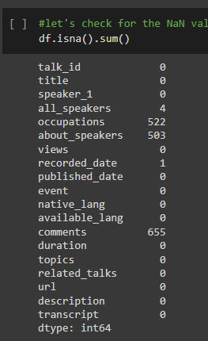
Checking Null values
Occupations, about_speakers, comments and recorded_date column contains the NaN values.
We can't get any input from url column for predicting the model. So, We can drop the url column

Slide 9
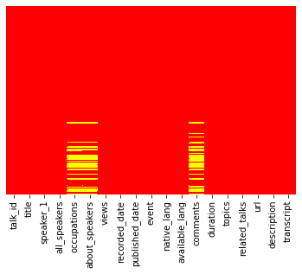
Visualizing the NULL values

Slide 10
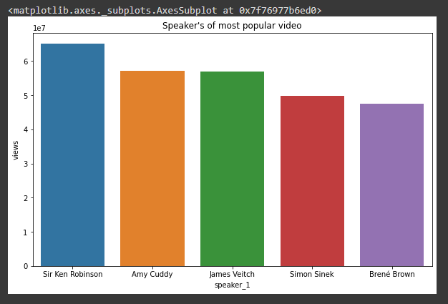
Top Speakers according to Views
Sir Ken Robinson's videos are most viewed followed by Amy Cuddy.
We will find the most popular speaker by taking reference of views column

Slide 11
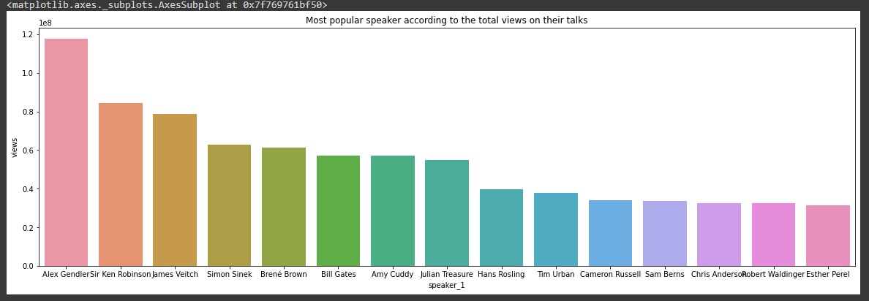
Most popular speaker according to the total views on their talks:
We can see Alex Gendler is the most popular speaker followed by Sir Ken Robinson.

Slide 12
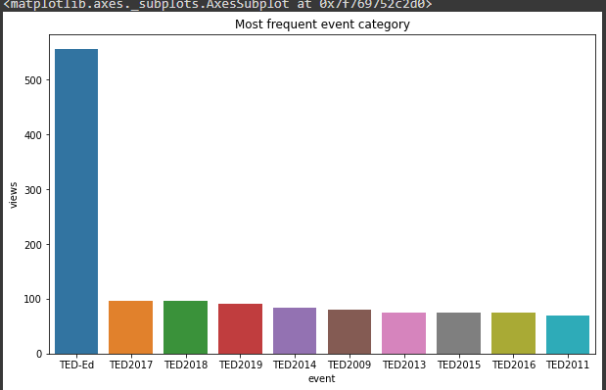
Most frequent event category
TEDEd is the most frequent event category followed by TED2017 and TED2018

Slide 13
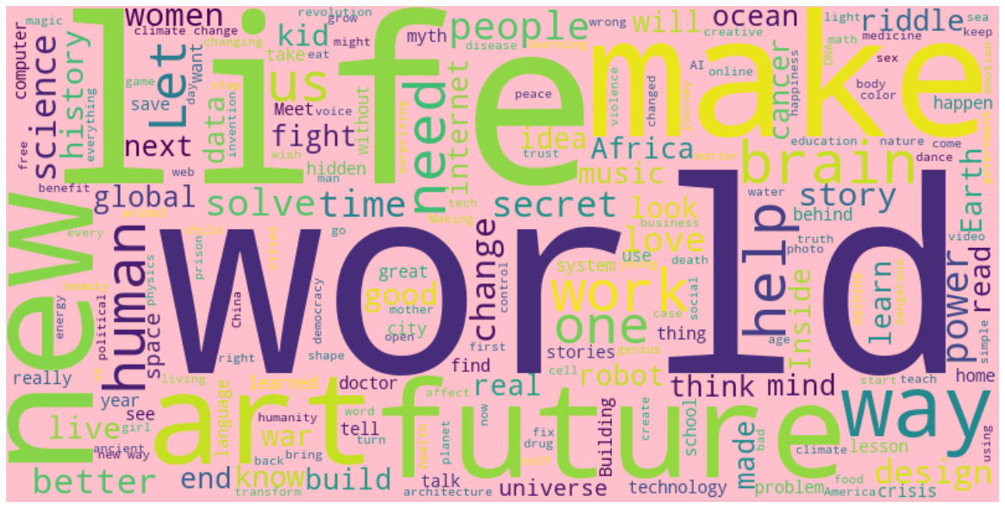
Most Popular Titles
There are 1,57,160 words in the combination of all titles
Majority of Titles contains words like life, world, make, new, future, art.

Slide 14

Most Popular Topic Tags
There are 4,04,126 words in the combination of all topics.
Majority of topic tags contain words like technology, global, science, issues, social change.

Slide 15
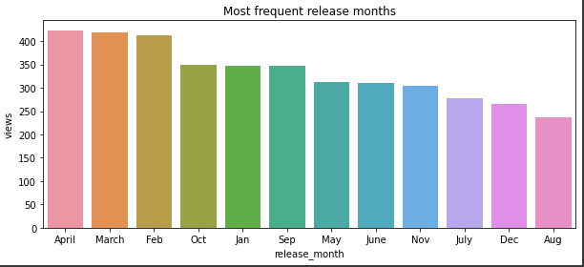
Most frequent release months
Maximum videos are released in April followed by March and Feb.

Slide 16
Feature Engineering
All machine learning algorithms use some input data to create outputs. This input data comprise features, which are usually in the form of structured columns. Algorithms require features with some specific characteristics to work properly. Here, the need for feature engineering arises. Feature engineering mainly have two goals:
Preparing the proper input dataset, compatible with the machine learning algorithm requirements.
Improving the performance of machine learning models
We'll try adding and removing some features in this section in
order to make a perfect data matrix we can pass to a machine learning model. We will try to interpret categorical features as numeric to be passed to the ML models.

Slide 17
The ML regressor models that we have used:
The ML regressor models that we have used are Lasso Regressor
Ridge Regressor
Random Forest Regressor
Gradient Boosting Regressor
XGB Regressor

Slide 18
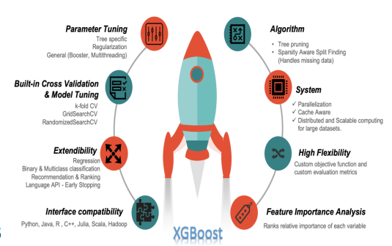
XGBoost Regressor
● MAE train:128550.389104
● MAE test: 169116.365352
● R2_Score train: 0.908523
● R2_Score test: 0.822761
● RMSE_Score train:244722.863246
● RMSE_Score test:348675.760125

Slide 19
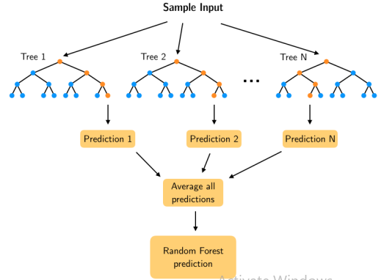
Random Forest Regressor
● MAE train:136962.506022 ● MAE test:146806.646689
● R2_Score train:0.849322 ● R2_Score test:0.822358
●RMSE_Score_train:
314081.297882
● RMSE_Score_test:
349072.13335

Slide 20
Which Model Did we Choose and Why?
As we know, RMSE is more influenced by outliers MAE doesn't increase with outliers.
MAE is linear and RMSE is quadratically increasing.
So, We choosed MAE as a deciding factor for our model.
On the basis of MAE, The best performing regression model is Random Forest Regressor.

Slide 21
Conclusion….
Performed Exploratory data analysis on various features, then carried out feature engineering and encoding of categorical columns, handled missing values in the dataset, dealt with outliers present in the dataset , performed transformations like log, sqrt and boxcox on numerical features to convert them to gaussian distribution, then carried out feature selection and build various models.
Following models have been used:
1--Linear Regressor
2--Random Forest Regressor
3--XGB Regressor
Evaluated these models on various metrics like MSE, RMSE, MAE ,R2 score and Adjusted R2 score. Finally selected the best model out of these.
In all these models our errors have been in the range of 2,00,000 which is around 10% of the average views. The model has been able to correctly predict views 90% of the time. After hyper parameter tuning, we have prevented overfitting and decreased errors by regularizing and reducing learning rate. Given that only have 10% errors, our models have performed very well on unseen data due to various factors like feature selection, correct model selection.
After evaluating the performance of all the models, the best model is Random Forest Regressor based on MAE because MAE is linear and robust to outliers.

